Slide 1
Toothpaste Dispenser
Designer: Chung-Hau Wang
2015.Jan.23

Slide 2
Outline
Overview
Components
How to use
How it works
  The Driving System
  The Dispensing System
  The Positioning System
Discussion

Slide 3
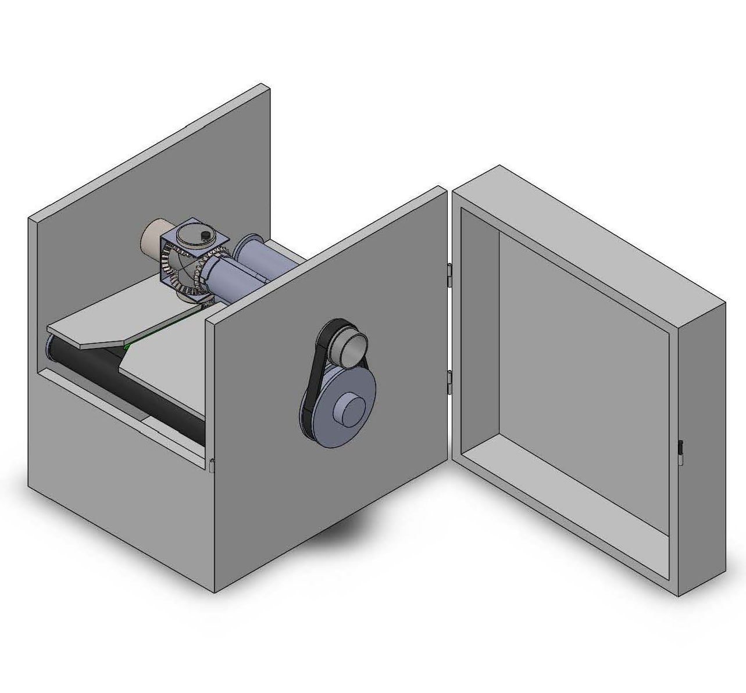
Overview
Dispensing System
This machine is achieved purely by mechanical mechanisms. It’s:
Comprised of general mechanical components only.
  Only gears, cylinders, screws and conveyor belts are involved. These components are general and easy to get.
Easy to repair.
  The dispensing system simply consists of one dispenser nozzle and four gears. The dispensing system will simply have the nozzles and gears replaced to be repaired, and the components are easy to mount and demount as seen.
Driving Pulley
(Power Input)
Conveyor Belt & Positioning System

Slide 4
Overview
Dispensing System
This machine is achieved purely by mechanical mechanisms. It’s:
Modular design.
  The whole machine system only needs one motor attaching to the driving pulley to be actuated so that…
  It has high flexibility in assembling and dissembling.
Highly compatible for production line.
  This machine utilizes conveyor belt transportation. It can be settled at the downstream of toothbrush’s production line or even share the conveyor belt with the production line.
  ...
Driving Pulley
(Power Input)
Conveyor Belt & Positioning System

Slide 5
Overview
Dispensing System
This machine is achieved purely by mechanical mechanisms. It’s:
Highly compatible for production line.
  ... This machine can also be connected to toothpaste production line by directly conducting the toothpaste flow to the dispensing system.
Driving Pulley
(Power Input)
Conveyor Belt & Positioning System

Slide 6
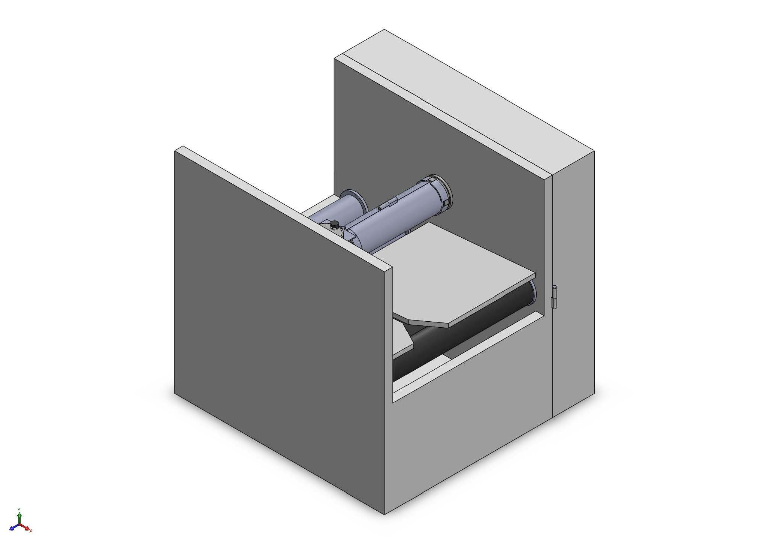
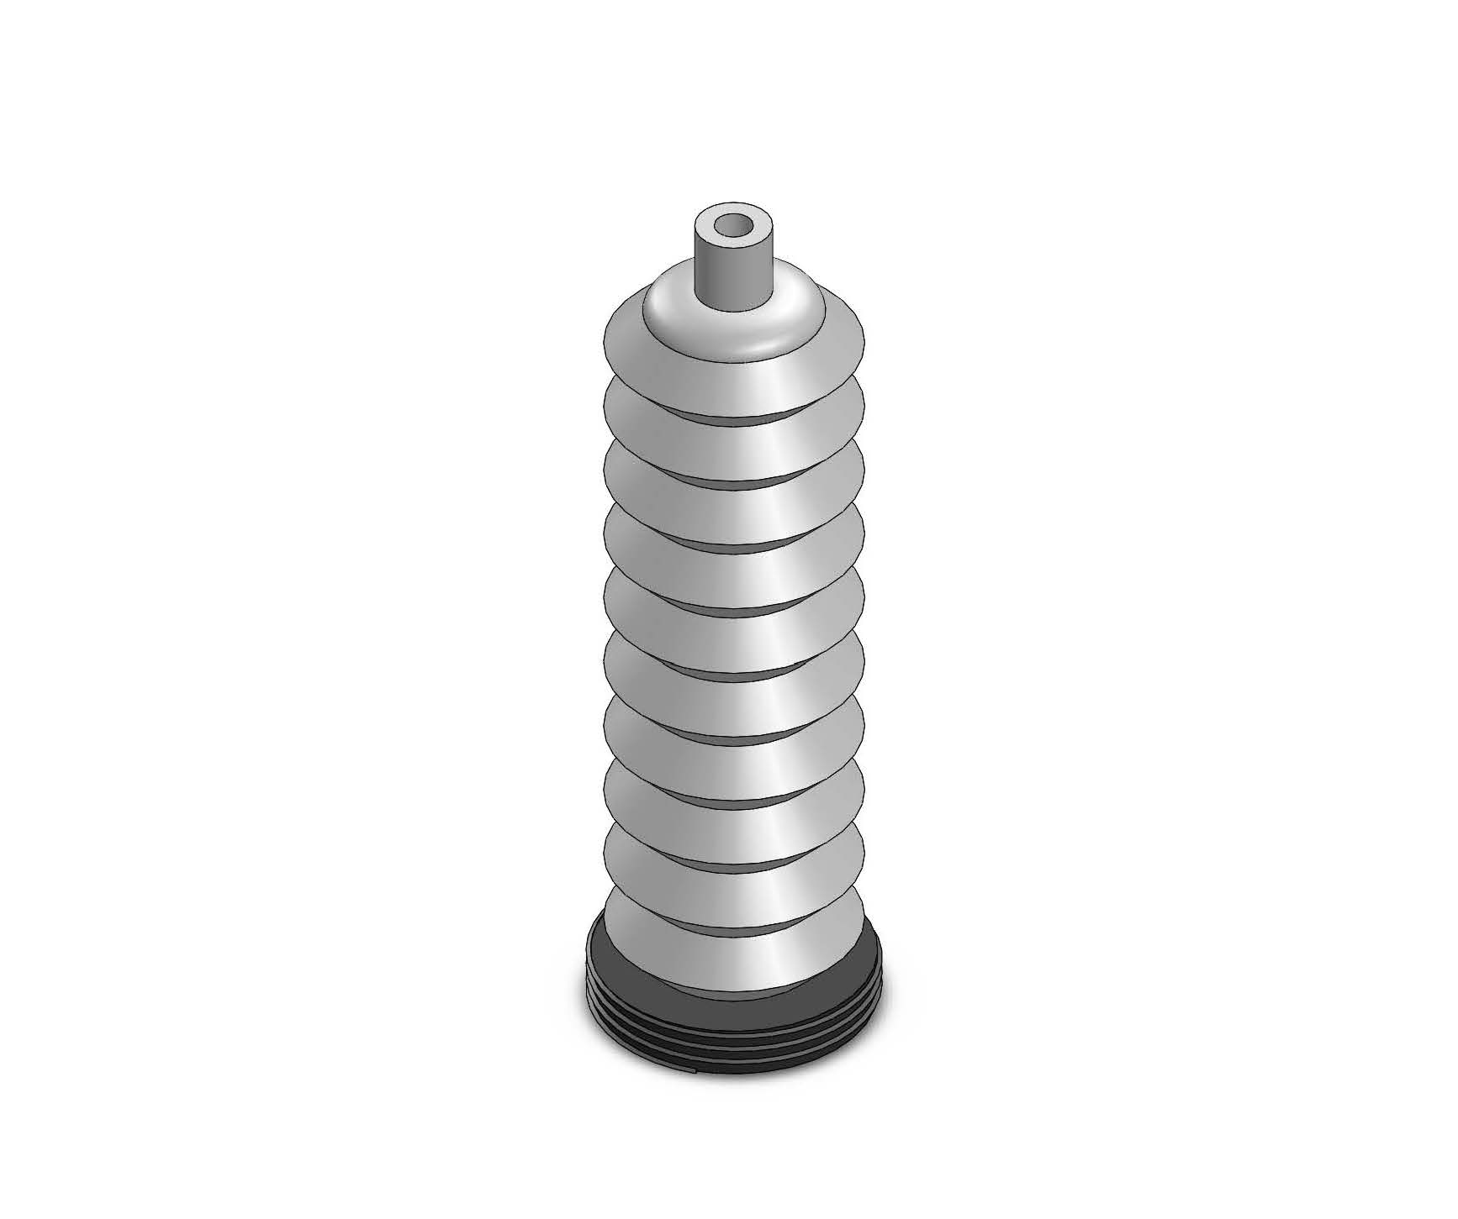
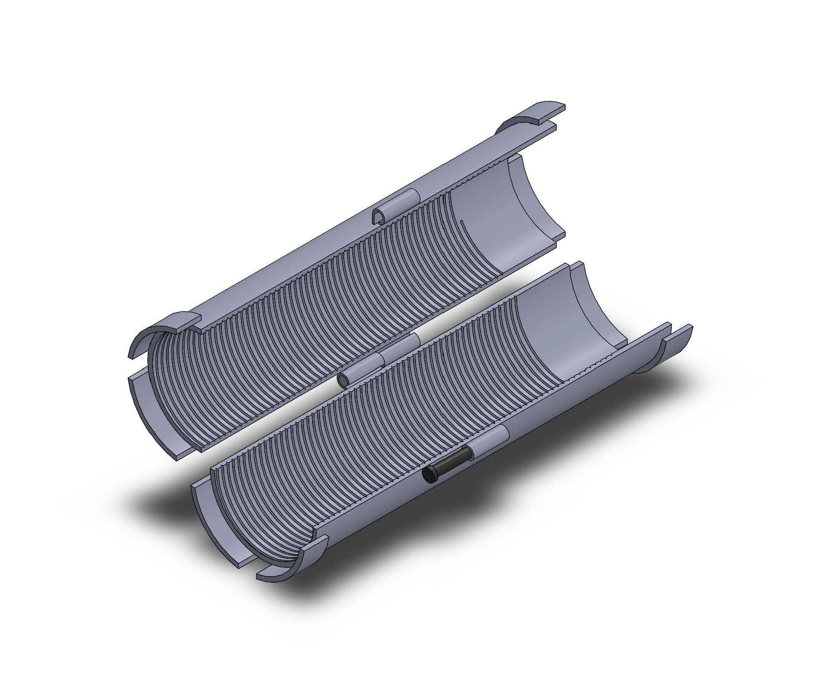
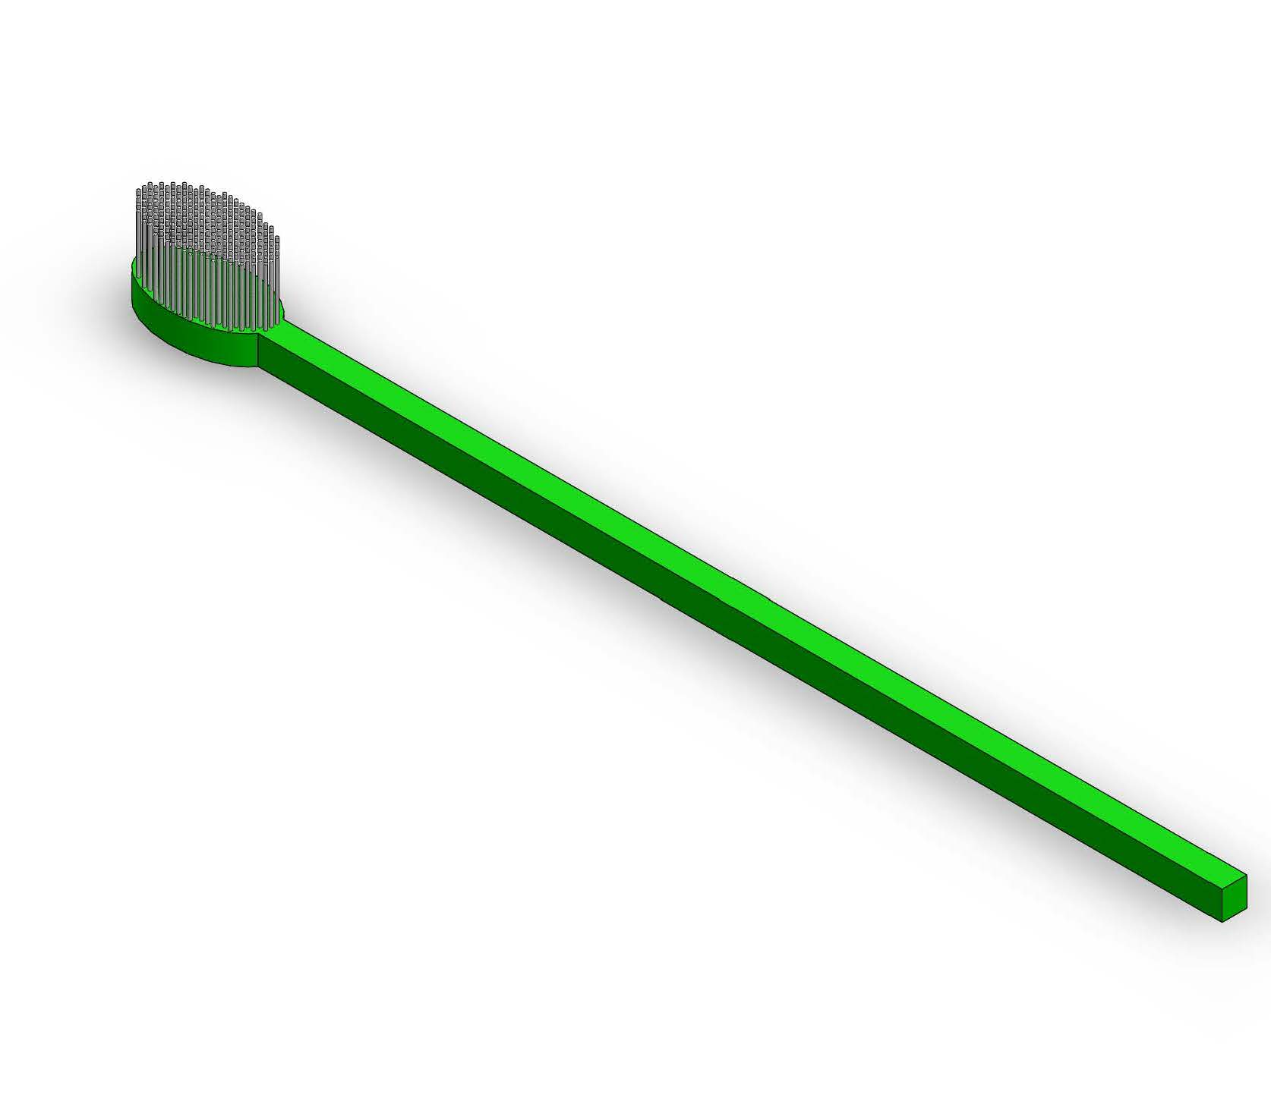
Components
Isometric view of the machine
Toothpastes
Toothpaste Wrap
Toothbrushes
1.
2.
3.
4.

Slide 7
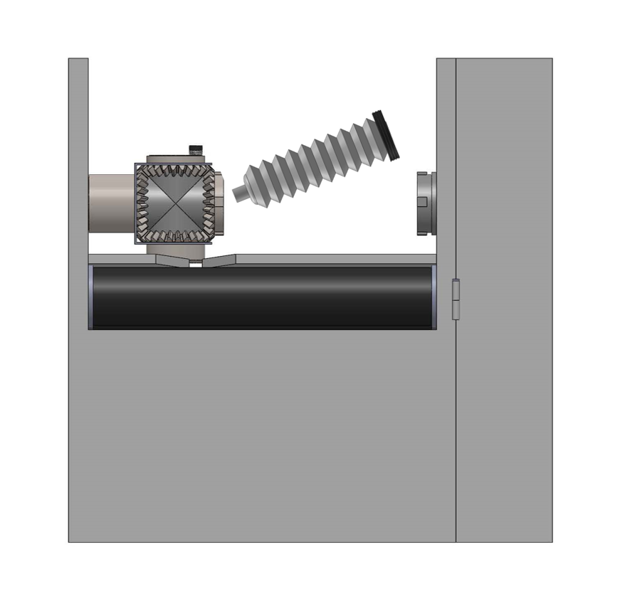
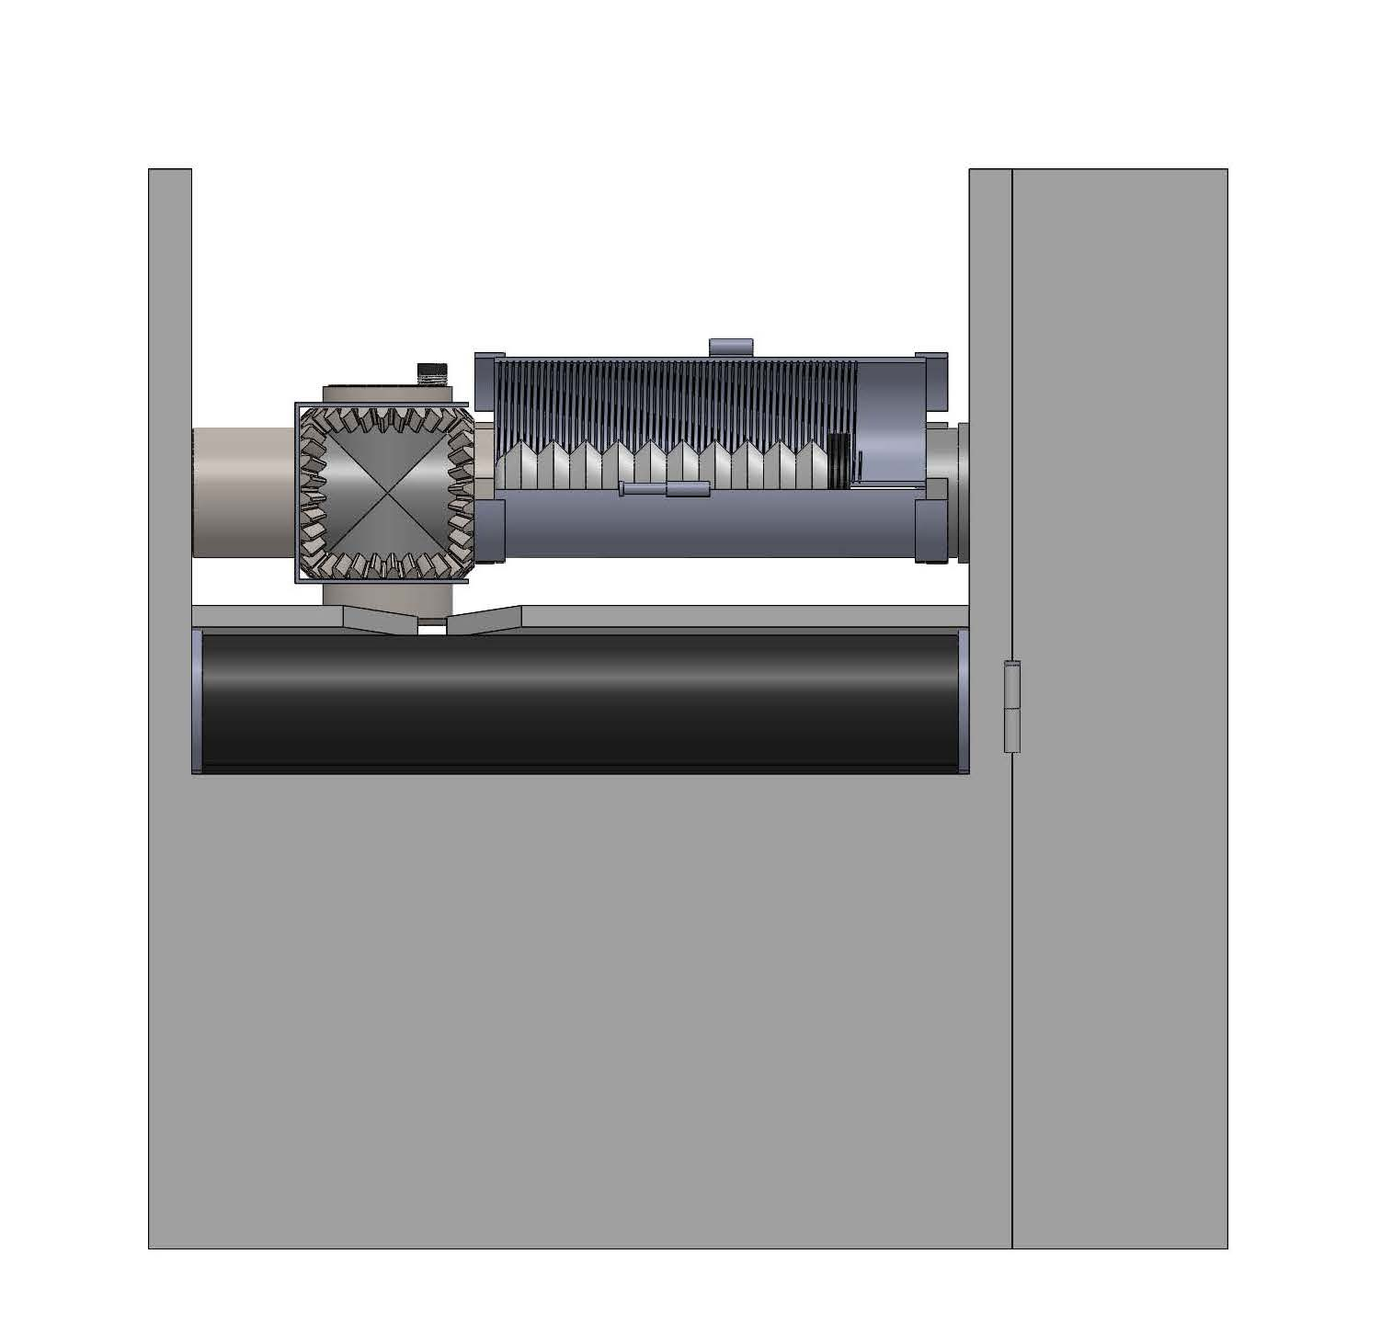
How to use?
Insert toothpastes
Mount the toothpaste wrap
1.
2.

Slide 8
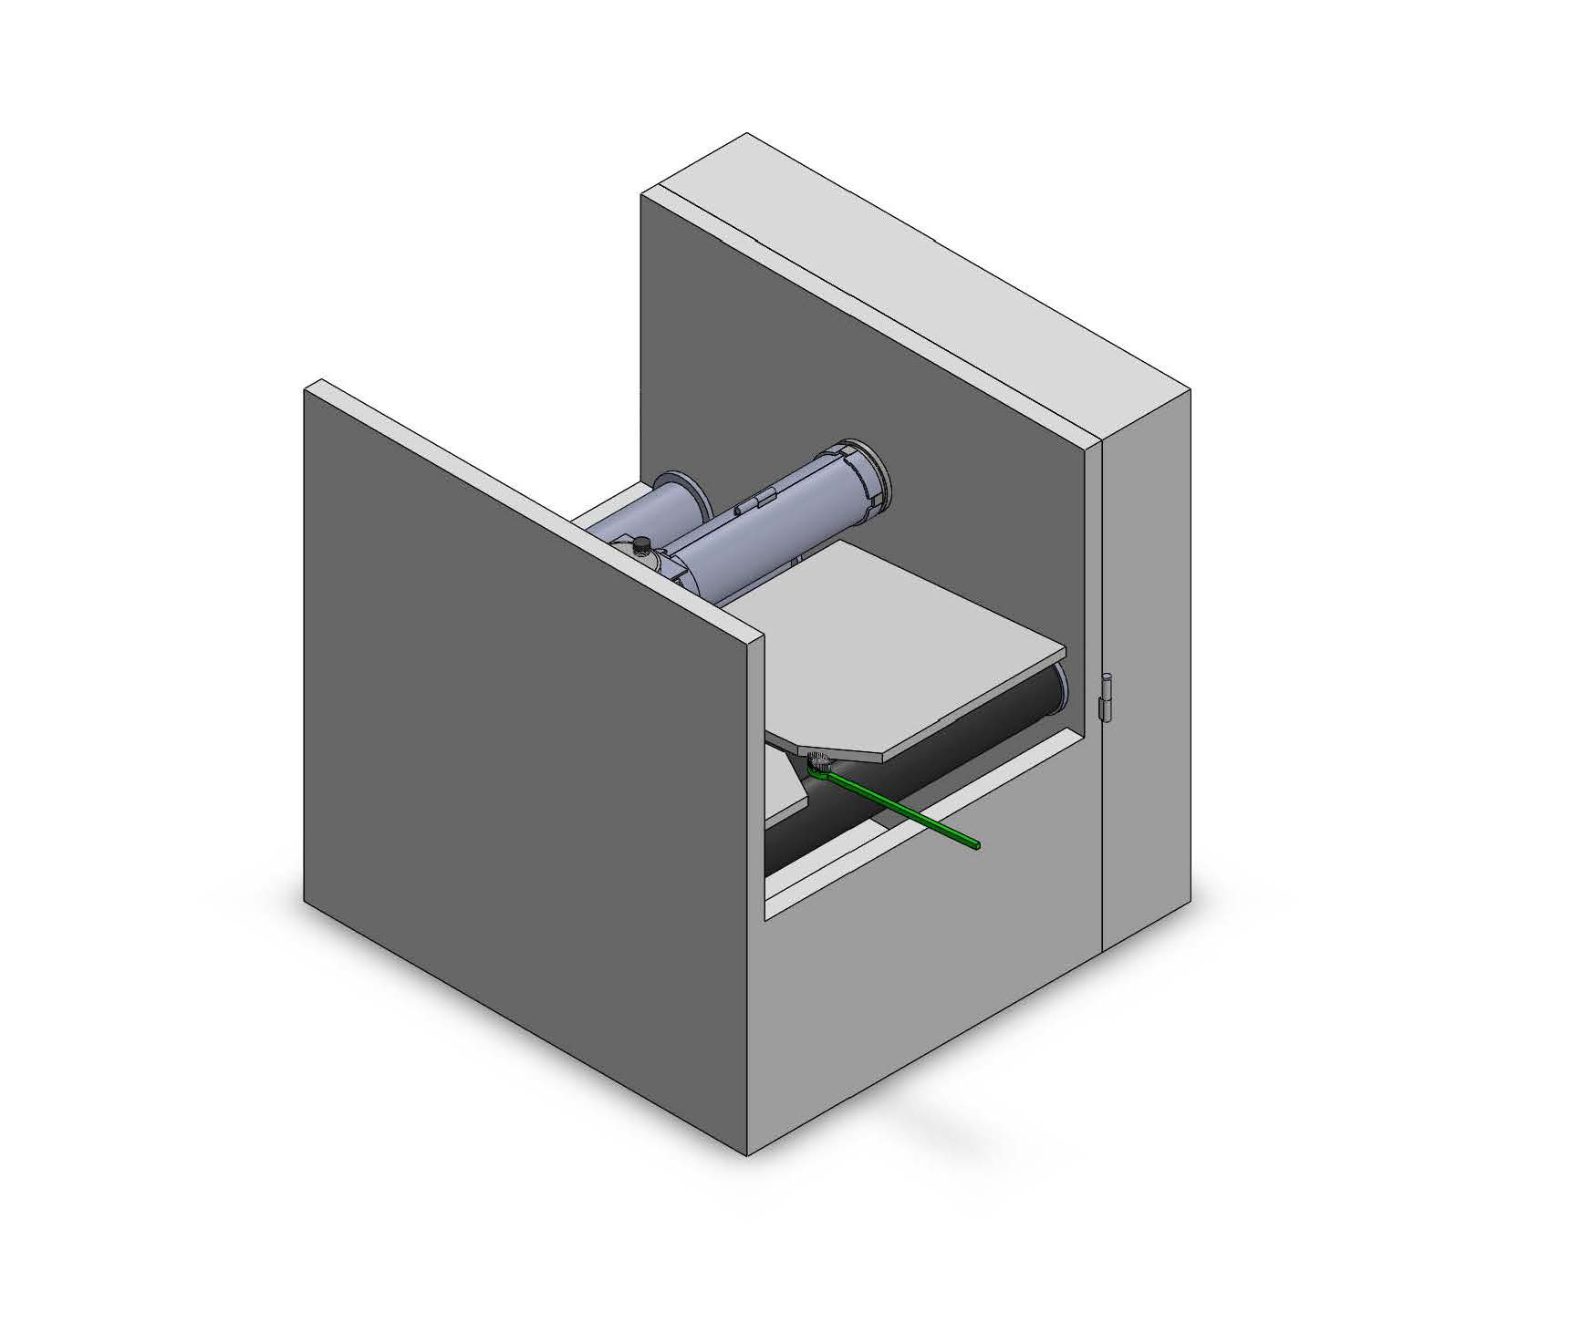
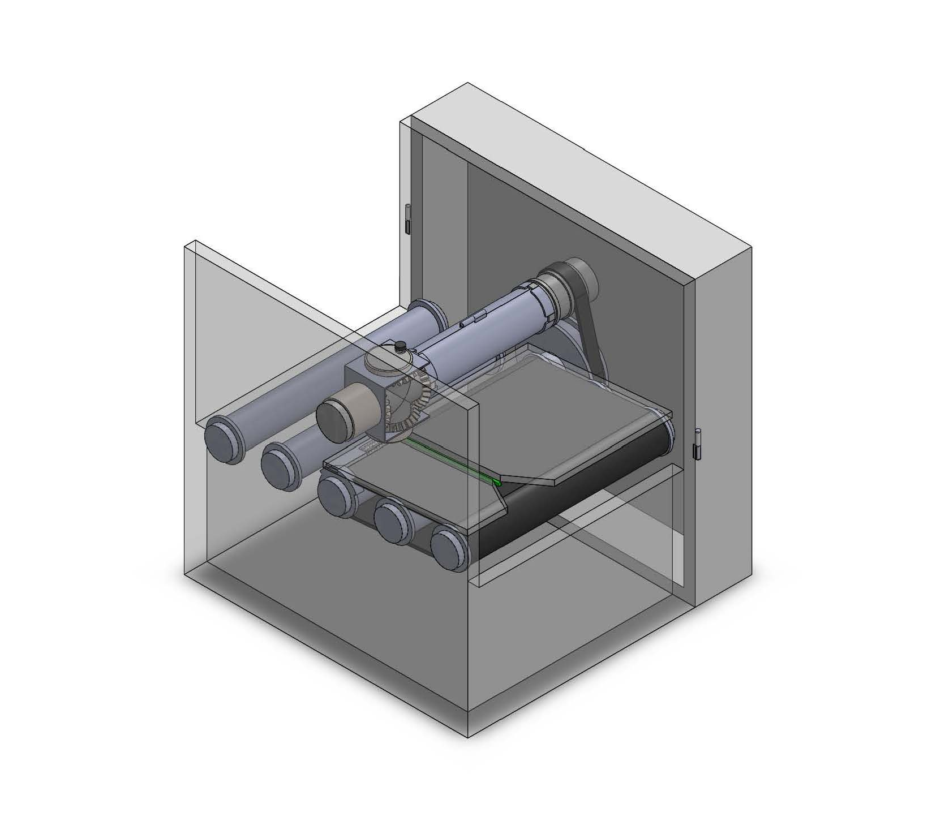
How to use?
Put in toothbrushes
Turn on the machine
3.
4.

Slide 9
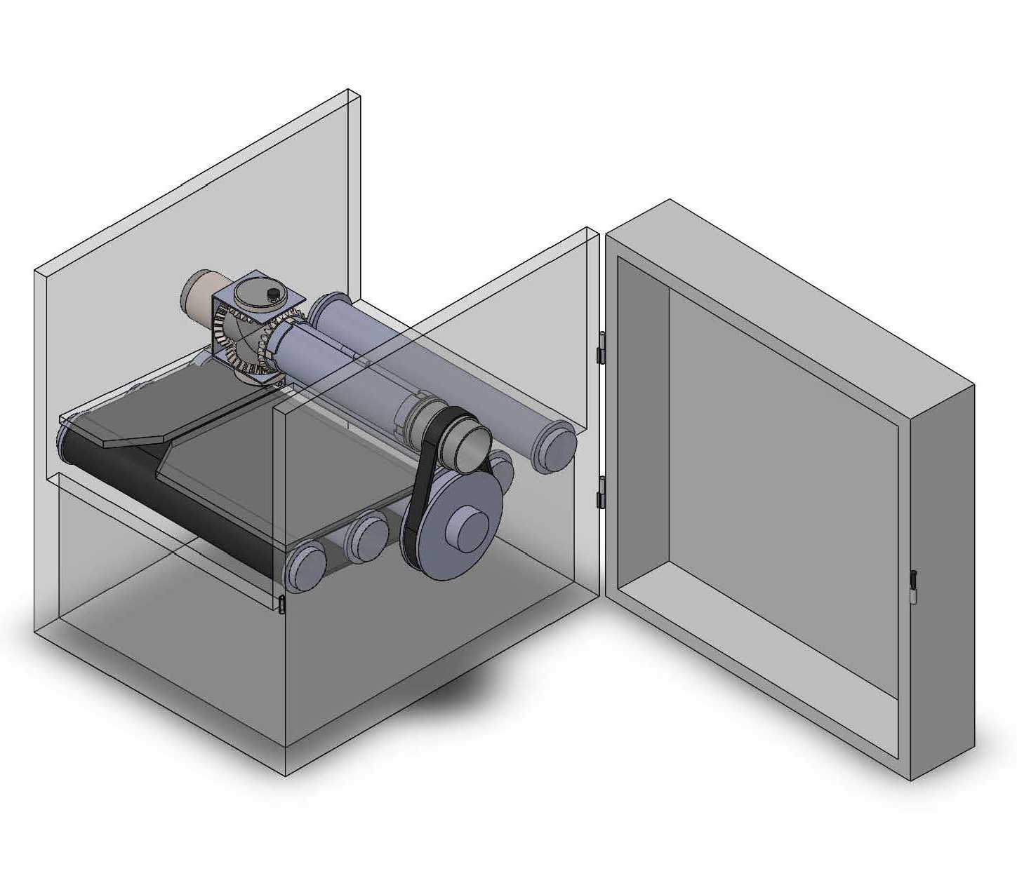
How it works?
The Driving System:
  The driving pulley is attached to motors to drive the transmission pulley and the whole machine.
  The transmission pulley could be associated with the driving pulley by belt, sprocket chain, or gears.
  The radius ratio (or gear ratio) between driving and transmission pulley is appropriately chosen (here the driving to transmission ratio is tentatively 2:1) so that the conveyor belt will let go of one toothbrush when the dispenser nozzle circles one round.
Dispenser Nozzle
Transmission Pulley
Driving Pulley
Conveyor Belt

Slide 10
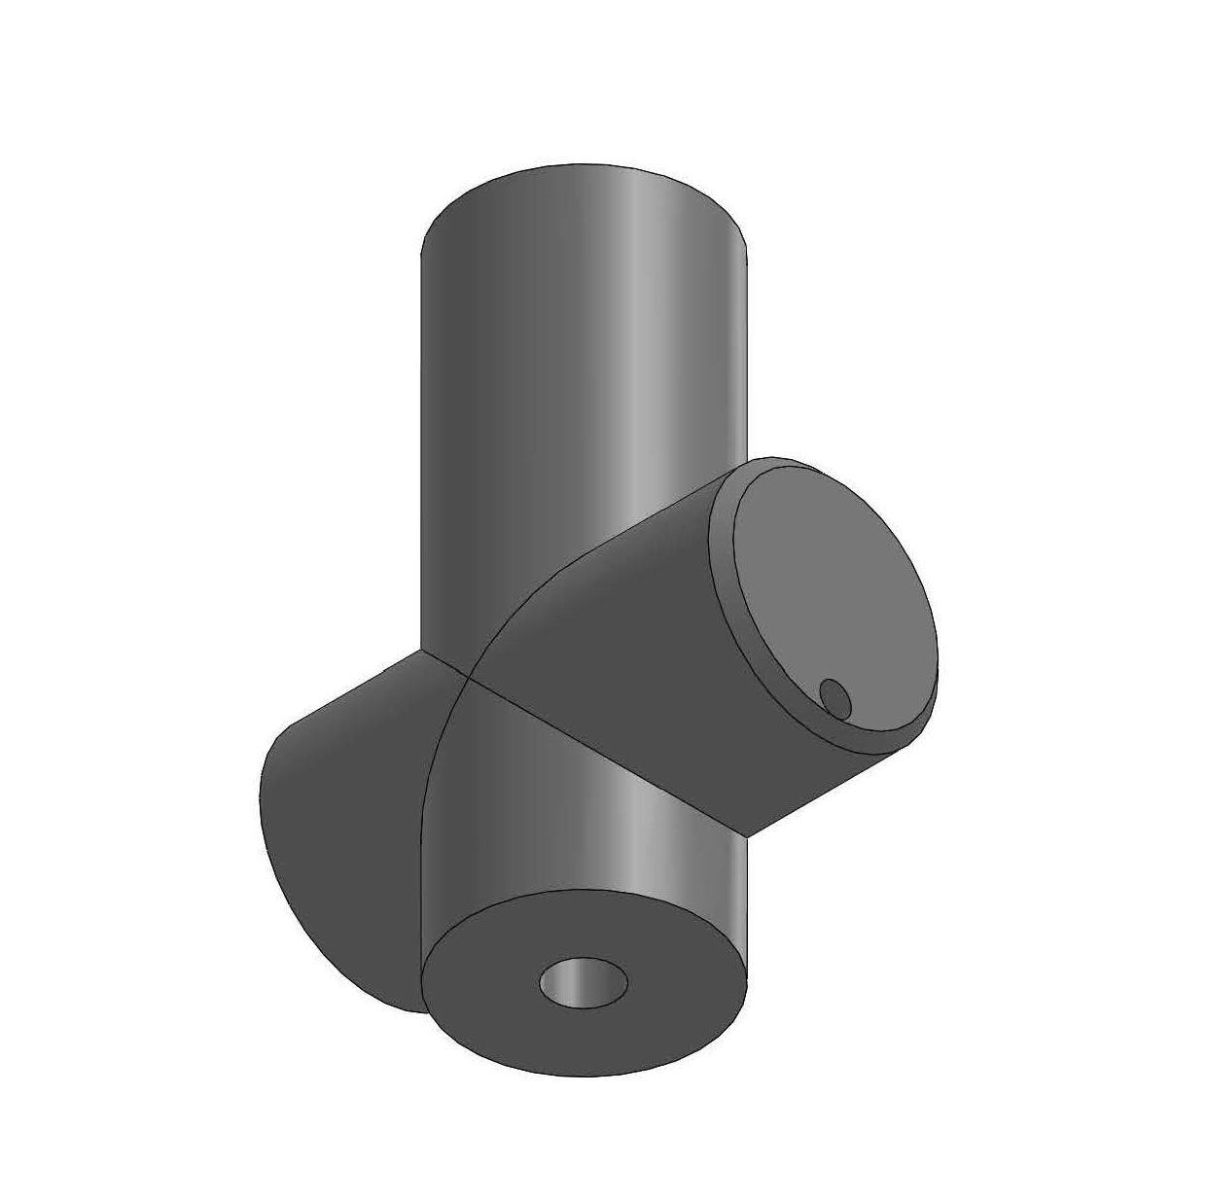
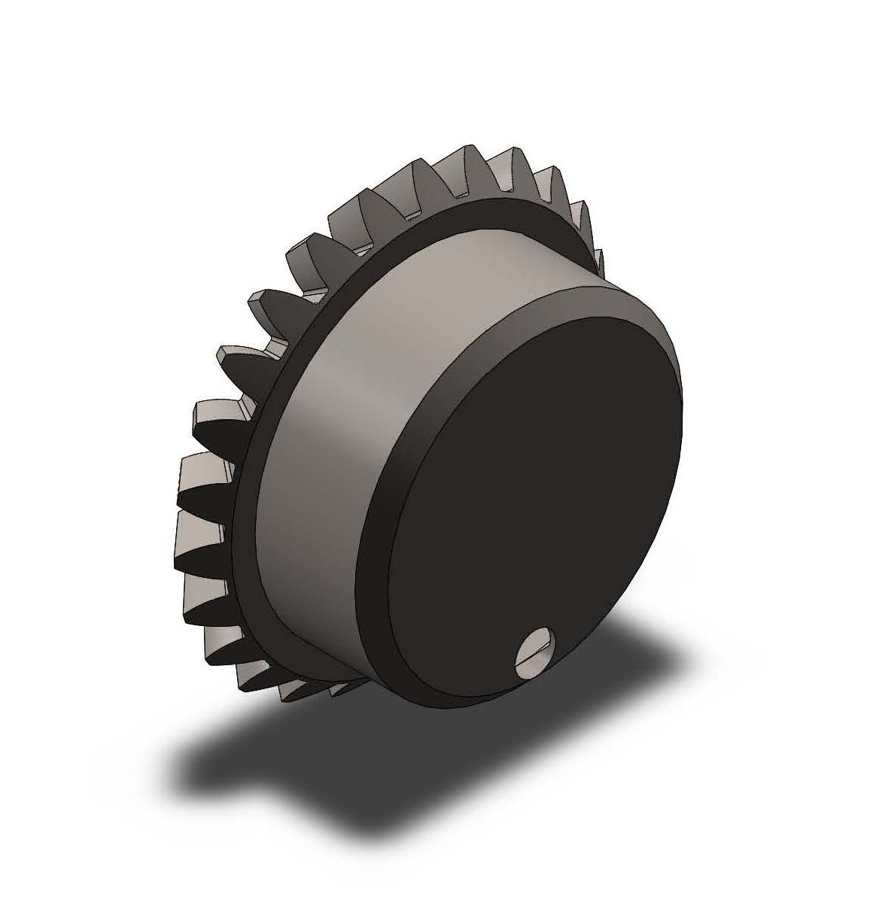
How it works?
Dispenser Nozzle
The Dispensing System:
  Dispenser nozzle has an incoming vent, which connects to the toothpaste’s nozzle; an outgoing vent, which will extrude toothpaste onto the toothbrushes; and on the opposite end to the outgoing vent has a vent connecting to a pressure balancer. dispenser nozzle has four arms to be mounted with the nozzle cap and three gears.
  Nozzle cap has an eccentric vent cut and is mounted to the end of the outgoing vent to work as a valve.
Outgoing Vent
1.
Nozzle Cap
Incoming Vent
Vent Cut
2.

Slide 11
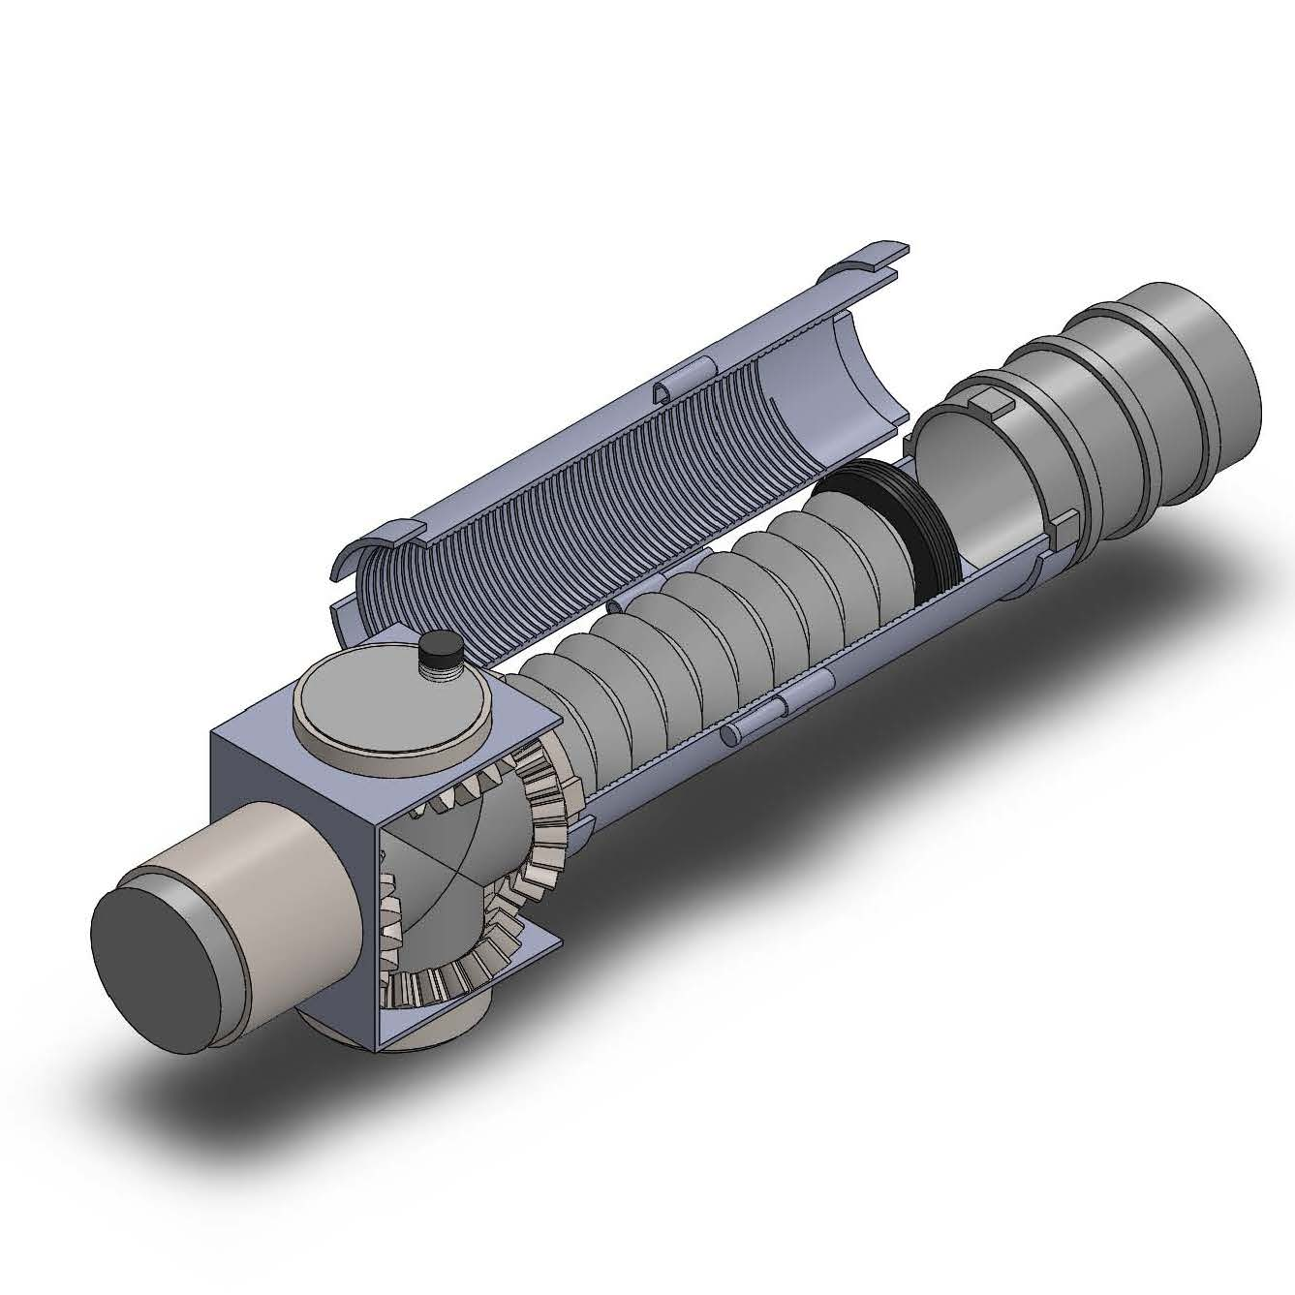
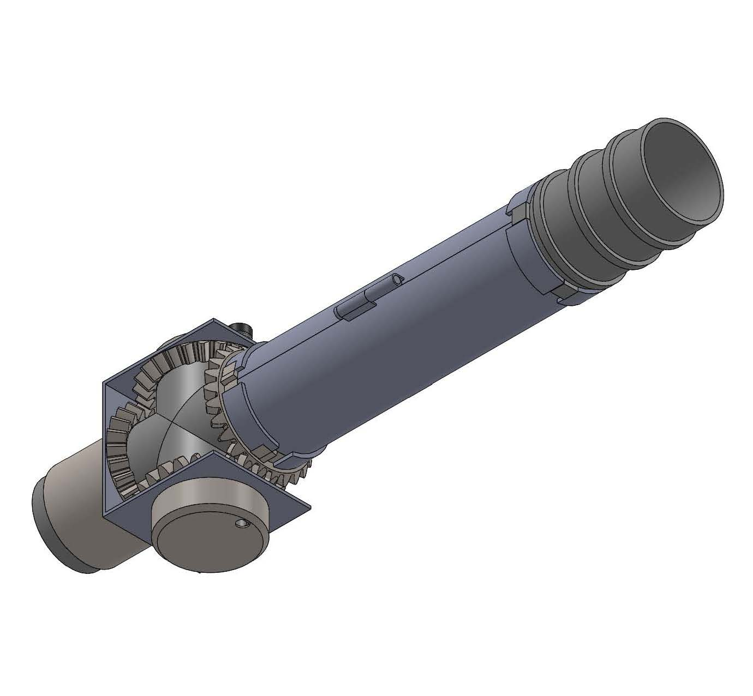
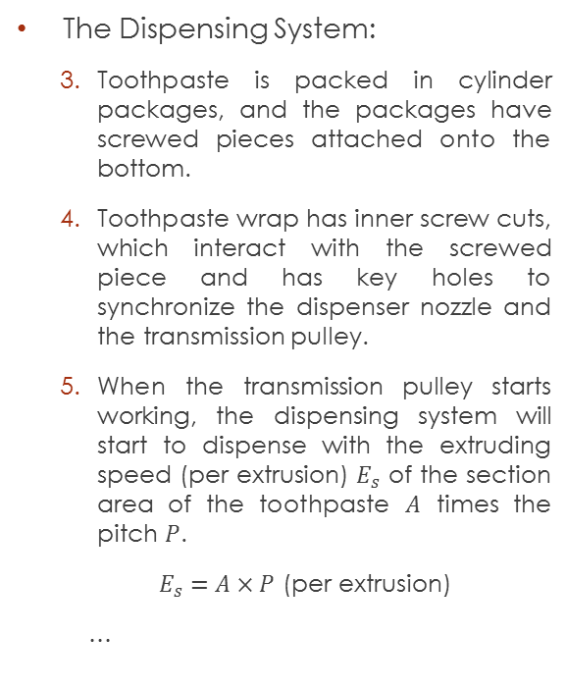
How it works?
Pressure Balancer
Toothpaste Wrap
Transmission Pulley
The Dispensing System:
  Toothpaste is packed in cylinder packages, and the packages have screwed pieces attached onto the bottom.
  Toothpaste wrap has inner screw cuts, which interact with the screwed piece and has key holes to synchronize the dispenser nozzle and the transmission pulley.
  When the transmission pulley starts working, the dispensing system will start to dispense with the extruding speed (per extrusion) $E_{s}$ of the section area of the toothpaste $A$ times the pitch $P$.
  $E_{s}=A×P$ (per extrusion)
  …
Screwed Piece
Toothpaste
Dispenser Nozzle
Fixed Gear
Dispenser Vent

Slide 12
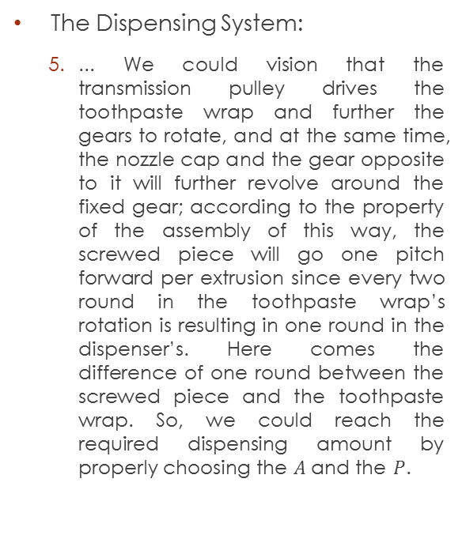
How it works?
Pressure Balancer
Toothpaste Wrap
Transmission Pulley
The Dispensing System:
  ... We could vision that the transmission pulley drives the toothpaste wrap and further the gears to rotate, and at the same time, the nozzle cap and the gear opposite to it will further revolve around the fixed gear; according to the property of the assembly of this way, the screwed piece will go one pitch forward per extrusion since every two round in the toothpaste wrap’s rotation is resulting in one round in the dispenser’s. Here comes the difference of one round between the screwed piece and the toothpaste wrap. So, we could reach the required dispensing amount by properly choosing the $A$ and the $P$.
Screwed Piece
(Synchronized with the dispenser nozzle)
Toothpaste
Dispenser Nozzle
Fixed Gear
Dispenser Vent

Slide 13
How it works?
Pressure Balancer
Toothpaste Wrap
Transmission Pulley
The Dispensing System:
  The dispenser vent will open once per round of dispenser nozzle’s rotation with the gear ratio set to be 1:1, and the pressure balancer will balance the pressure in the dispenser nozzle when the vent is closed.
Screwed Piece
(Synchronized with the dispenser nozzle)
Toothpaste
Dispenser Nozzle
Fixed Gear
Dispenser Vent

Slide 14
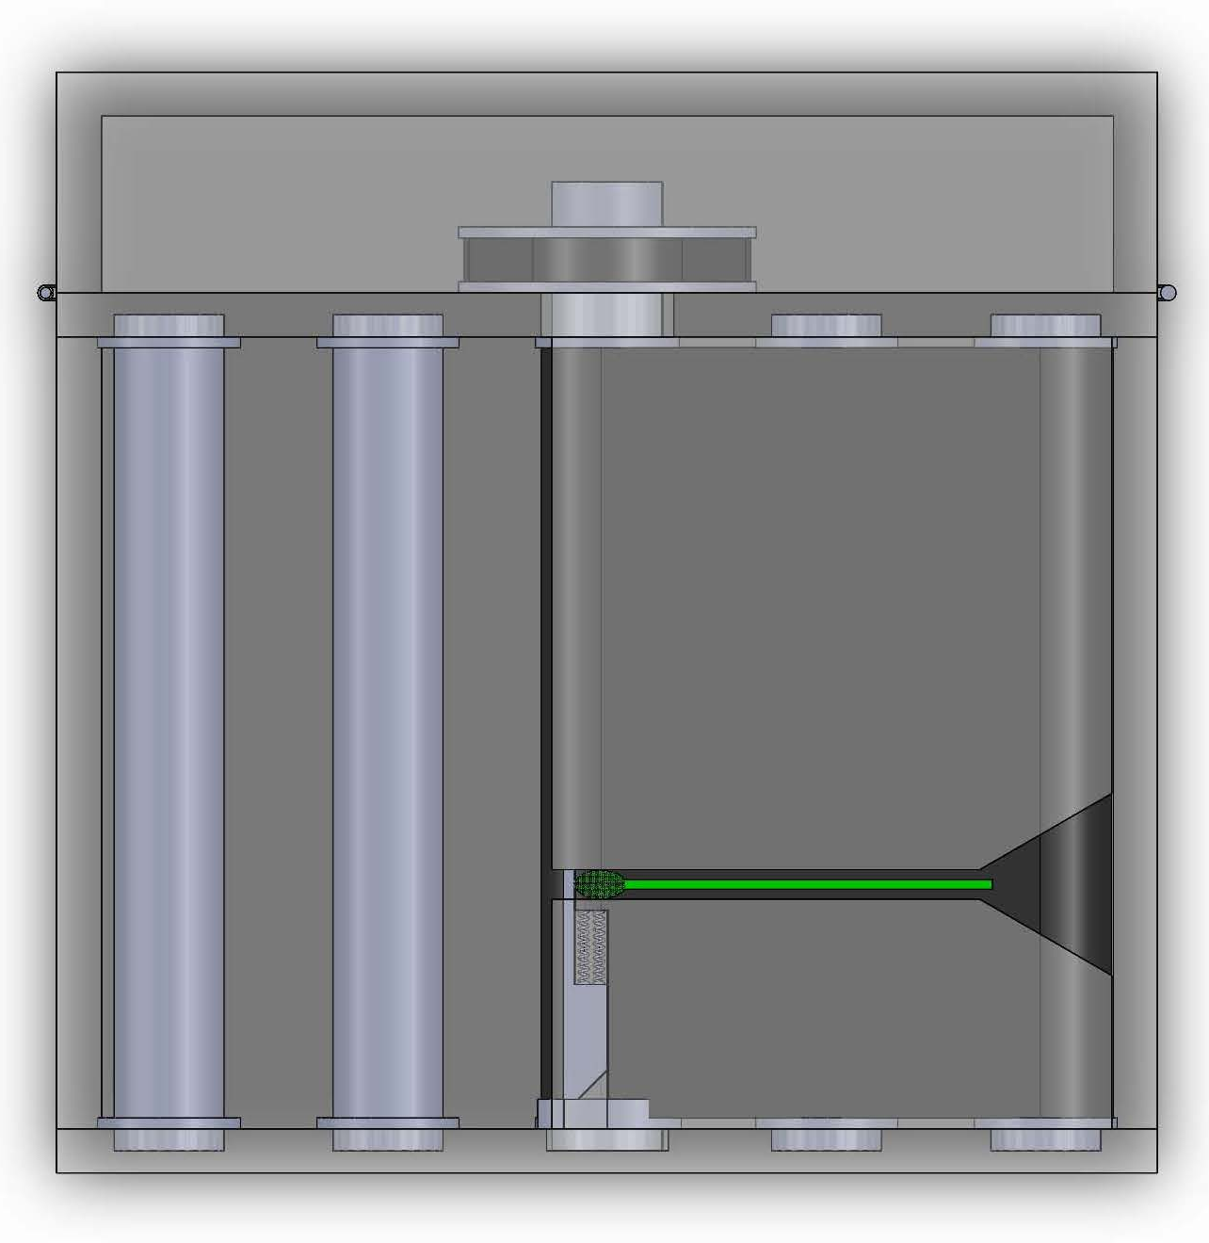
How it works?
The Positioning System:
  Driving roller is mounted with a driving pulley at one end and attached with a cam at the other. Driving roller associates other rollers by the conveyor belt to transport toothbrushes through the path to be toothpasted.
  Blocking bolt is to position the toothbrushes. Blocking bolt interacts with the cam and blocks per every toothpaste extrusion.
Driving Pulley
Blocking Bolt
Driving Roller with Cam

Slide 15
Discussion
Pure mechanical mechanism design offers a sensor-free and control-free system. All the mechanical components are associated with each other by their mechanical properties, and only one general motor will be needed to drive the whole machine. The complexity and further the cost of the machine will be then greatly decreased. Furthermore, by the use of the blocking bolt we’ll still be able to squeeze toothpaste precisely onto the toothbrushes without the need of precision positioning methods.
Rotating dispenser nozzle will distribute toothpaste on the entire bristle surface of the toothbrushes; the distribution can avoid toothpaste dripping.
The dispenser vent should locate eccentrically to the rim in order to make sure the vent opens within the bristle area, closes before getting out of the area, and not to crash into the toothbrushes.

Slide 16
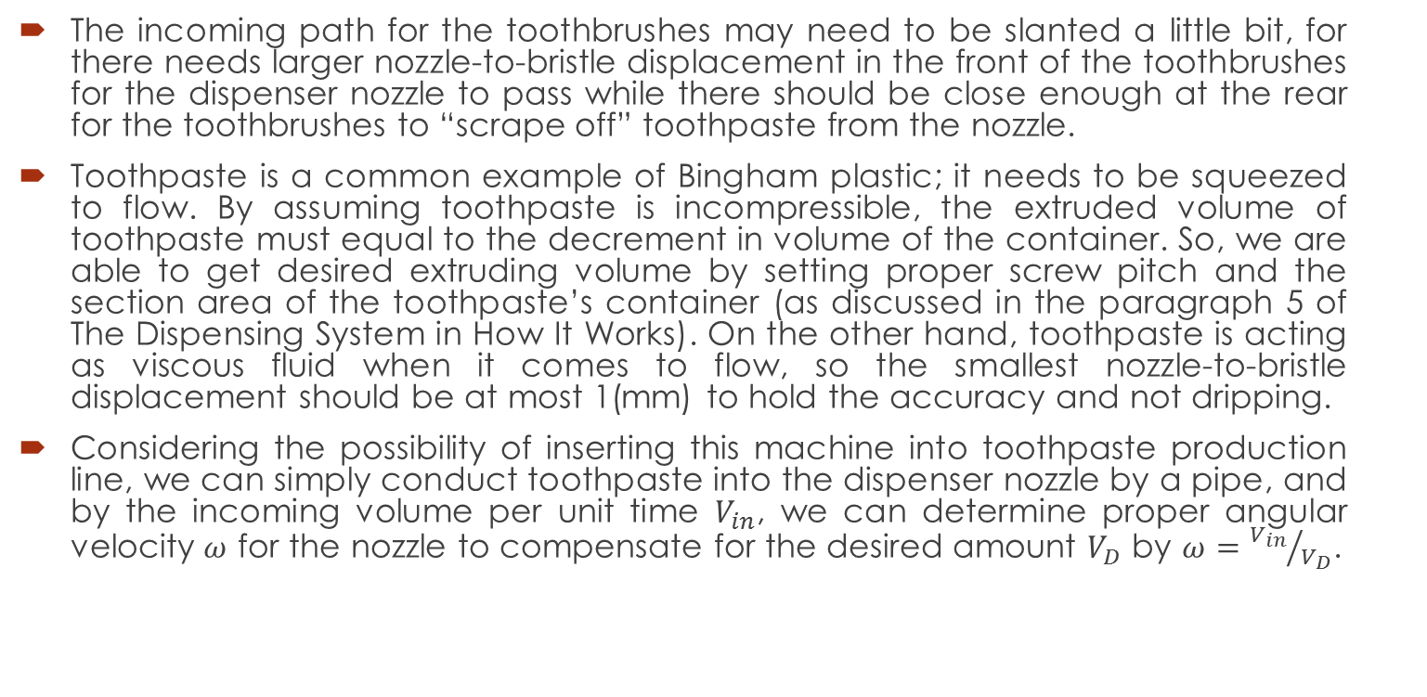
Discussion
The incoming path for the toothbrushes may need to be slanted a little bit, for there needs larger nozzle-to-bristle displacement in the front of the toothbrushes for the dispenser nozzle to pass while there should be close enough at the rear for the toothbrushes to “scrape off” toothpaste from the nozzle.
Toothpaste is a common example of Bingham plastic; it needs to be squeezed to flow. By assuming toothpaste is incompressible, the extruded volume of toothpaste must equal to the decrement in volume of the container. So, we are able to get desired extruding volume by setting proper screw pitch and the section area of the toothpaste’s container (as discussed in the paragraph 5 of The Dispensing System in How It Works). On the other hand, toothpaste is acting as viscous fluid when it comes to flow, so the smallest nozzle-to-bristle displacement should be at most 1(mm) to hold the accuracy and not dripping.
Considering the possibility of inserting this machine into toothpaste production line, we can simply conduct toothpaste into the dispenser nozzle by a pipe, and by the incoming volume per unit time $V_{in}$, we can determine proper angular velocity $ω$ for the nozzle to compensate for the desired amount $V_{D}$ by $ω={V_{in}}/{V_{D}}$.

Slide 17
The End
Thank You

